Slide 1
BUSQOM 1080 Multiple Regression I
Fall 2020
Lecture 11
Professor: Michael Hamilton

Slide 2
Lecture Summary
Recap simple linear regression. [5 Mins]
Introduction to Multiple Linear Regression [10 Mins]
Example of linear regression with two features [5 Mins]
Multiple Regression in R [5 Mins]
Simple Regression → Multiple Regression [10 Mins]
Adjusted R² [5 Mins]
Multicollinearity [5 Mins]

Slide 3
Data for lecture
Save mlb.txt in your working directory
mlb =read.table("mlb.txt", sep = "\t", header = T)
30 Teams
Stats from ‘17
Column Name | Variable Definition
AvgRuns | Runs Scored Per Game
OBP | On-Base Percentage
SLG | (Total Bases)/(At Bats)
OPS | One base plus slugging
HR | Homeruns
Many others | ~Baseball Stuff~

Slide 4
Review: Simple Linear Regression
Assumed Probabilistic Linear Model: Assume a linear relationship between X & Y exists
Error term is assumed to be Normal with mean 0
Observed Y values can be expressed as:
Use data to estimate that linear relationship with a straight line:
The straight line (average)
Deviation from the line

Slide 5
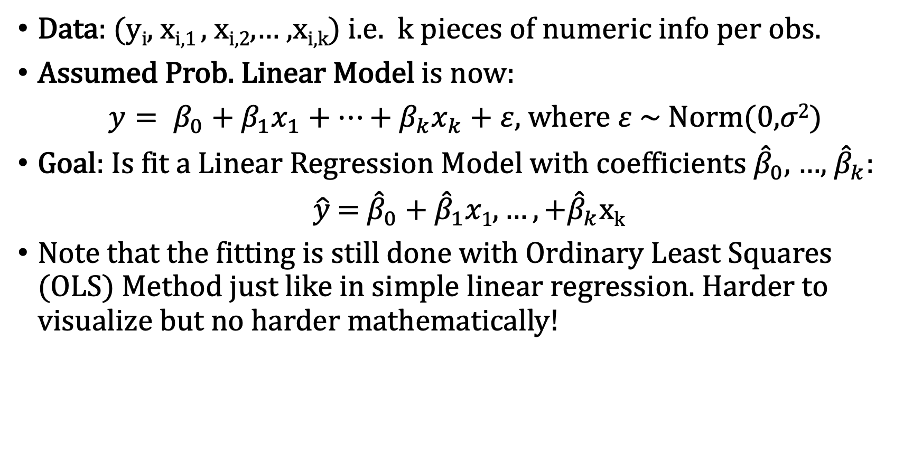
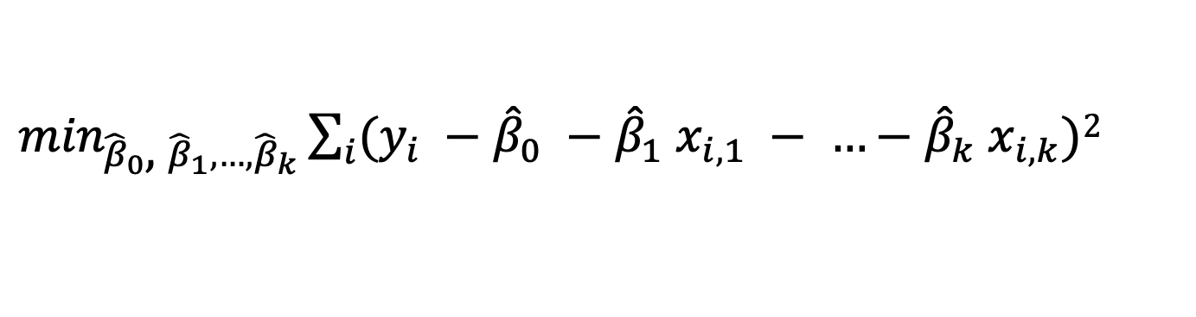
Topic: Multiple Linear Regression
Data: (y_{i}, x_{i,1} , x_{i,2},… ,x_{i,k}) i.e. k pieces of numeric info per obs.
Assumed Prob. Linear Model is now:
$y= β_{0}+β_{1}x_{1}+…+β_{k}x_{k}+ε,$ where $ε$ ~ Norm(0,$σ2$)
Goal: Is fit a Linear Regression Model with coefficients ${\hat{β}}_{0},$…, ${\hat{β}}_{k}$:
$\hat{y}$ = ${\hat{β}}_{0}\text{ +} {\hat{β}}_{1}x1, …,+{\hat{β}}_{k}$x_{k}
Note that the fitting is still done with Ordinary Least Squares (OLS) Method just like in simple linear regression. Harder to visualize but no harder mathematically!
$\min_{{\hat{β}}_{0}\text{, }{\hat{β}}_{1}, …,{\hat{β}}_{k}}\sum_{i}{(y_{i} −{\hat{β}}_{0} −{\hat{β}}_{1} x_{i,1} − …−{\hat{β}}_{k} x_{i,k})}$²

Slide 6
Example: Regression with two independent/explanatory variables
Question: How is the number of runners left on base (LOB) related to Hits (H) and Strikeouts (SO)?
Intuition: More Hits means more opportunities to be left on base.
Intuition: More Strikeouts means more runners left on base.
Intuition: Also though, more hits should mean less Strikeouts, at least weakly.
Let’s fit a linear model to find out the relation (if any!).

Slide 7
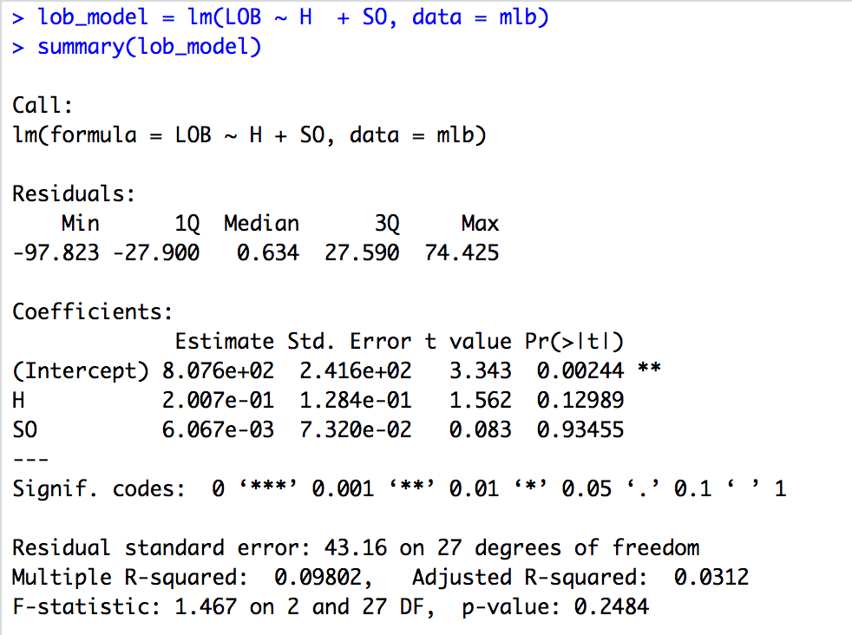
Topic: Multiple Regression in R
List all explanatory variables; separate with “+”
Regression Equation:
LOB=807.6 + .2007 Hits + .006067*Strikeouts

Slide 8
Questions to Consider About the Model
Is the overall model (regression equation) useful? i.e. are any of the fitted coeff. significant?
Which features are “significant” and what does that mean?
Are the various features positively or negatively related to the response? How do we interpret them?
How much of the variability in the response variable is explained by the model?
Do the assumptions of the Assumed Probabilistic Linear Model hold? If they do, so what?

Slide 9
Topic: Multiple Regression in R
The F-test basically tells us if at least one of the explanatory variables is useful
Small p-value → useful model*
*or at least not a totally null model

Slide 10
Topic: Multiple Regression in R
Using p-values, we can determine neither variable is significant, but Hits is somewhat close. We can also read off their estimated coefficients in the multiple linear regression model

Slide 11
Topic: Multiple Regression in R
What about the overall amount of variation in the data explained by the model?
Multiple R-squared = 0.09
Adjusted R-squared =0.03
What is the Adjusted R² and should we prefer it?

Slide 12
Model Fit: R² versus Adjusted R²
The R² is the proportion of variability in Y accounted for by the model (i.e. predictor variable(s))
The Adjusted R² accounts for the number of parameters in the model (incurs a penalty for each additional variable)
R-sq(adj) = 1-[(n-1)/(n-p)](1-R²), where n = # observations, p = # predictors
Idea: The more predictors you have in the model the lower the sum of squared residuals, the higher R², indicating the better prediction for the response, even though some of the predictor variables are not necessary
In this class we will always use and prefer adjusted R²

Slide 13
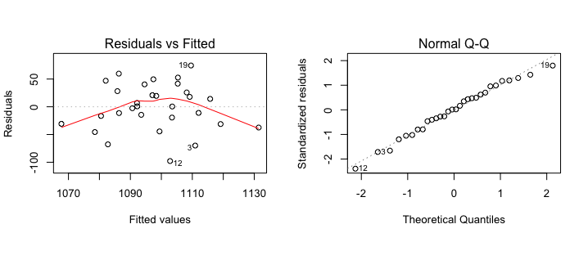
Checking Multiple Regression Assumptions
Same as four as Simple Linear Regression
Linear + Constant Variance – Check Residuals v Fitted
No funnel shape (increasing variance)
Not much of a curvilinear pattern
➔ Linearity and Equal Variance assumptions are reasonably satisfied (not great though)
Normality of Errors – qqplot of residuals
Data is very close to line that represents a normal distribution
Normality assumption satisfied

Slide 14
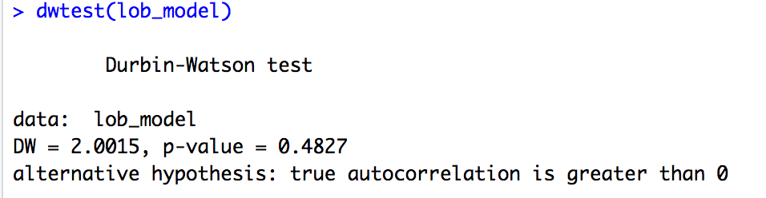
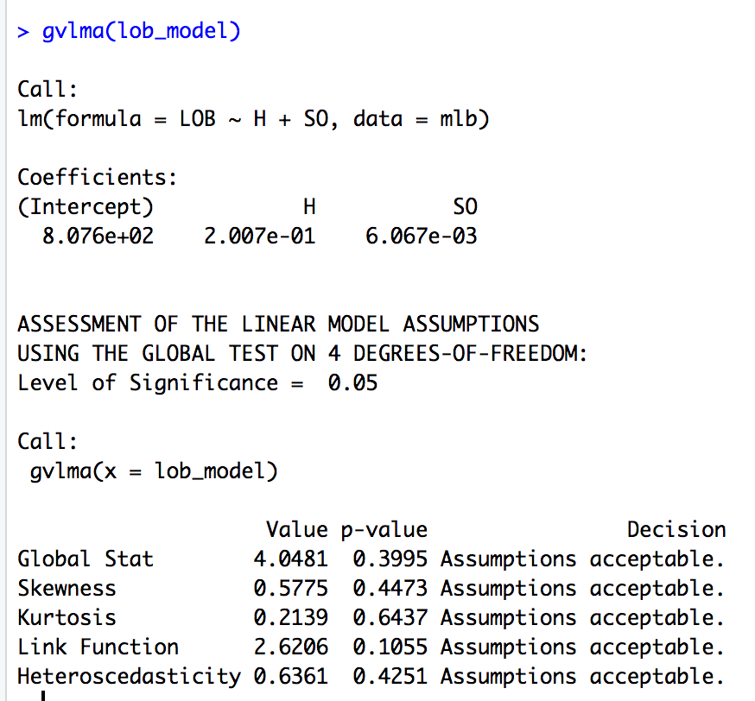
Checking Multiple Regression Assumptions
Independence between features and noise, still use the dwtest()
p-value > 0.1 tells us that the residuals are NOT correlated
➔ Independence assumption satisfied
GVLMA approach also the same
Regression assumptions satisfied
Appropriate to use for predictions

Slide 15
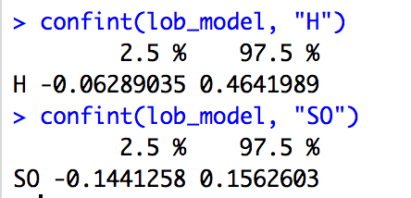
Confidence intervals for the coefficients
If the assumptions hold we can generate confidence intervals around the coefficients just like before. In R use confint()
Note both intervals contain 0
Interval includes 0 ➔ consistent with t-test result; not statistically significant
Interpretation of CI is the same as before, for every strike out the expected number of batters left on base is between -.144 and .156

Slide 16
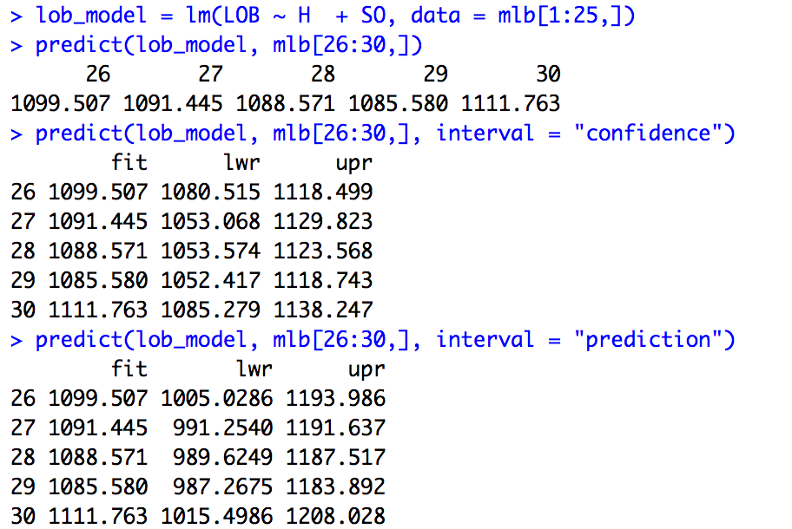
Topic: Prediction with Multiple Lin. Reg.
Same idea a simple linear regression, but more difficult to visualize. In R just make a dataframe of obs. and call predict()
Same as in simple linear regression case

Slide 17
Topic: Multicollinearity
As the number of predictors increases, multiple regression modeling can become very complicated.
Multicollinearity is when the predictors in the regression equation are correlated with each other.
Example:
Suppose you use both height and arm length as features in a to predict a potential athlete's future vertical leap.
Note height and arm length are highly correlated with each other! Thus having both height and arm length in your multiple regression equation may only slightly improve the R² over an equation with just height.
Might conclude that height is highly influential on vertical leap, while arm length is unimportant (or vice versa) which is not true!

Slide 18
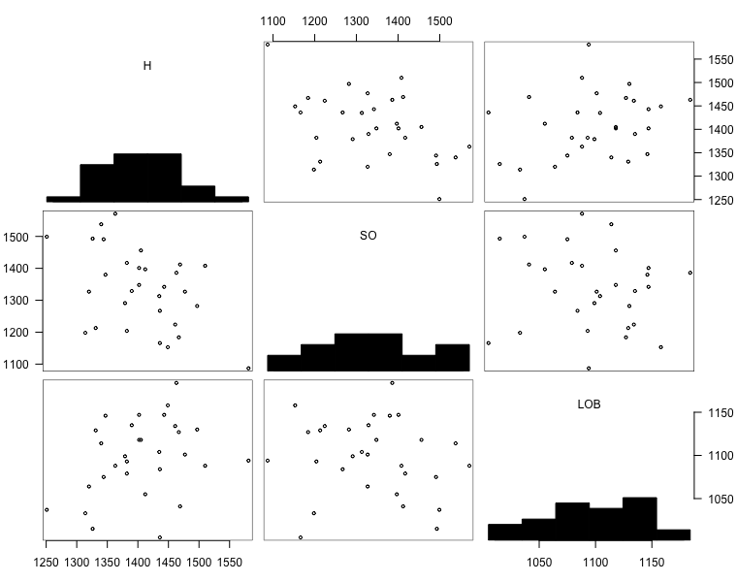
How to check for multicollinearity?
Visually:
Scatterplots, Scatterplot Matrix
> install.packages("gpairs")
> library(gpairs)
> gpairs(mlb[,c("H", "SO", "LOB")])
A scatterplot matrix is a matrix of scatterplots, one plot for each pair of variables.
Note: To read it, pick a plot in the matrix. Look in the column for the X variable and the row for the Y variable

Slide 19
What to do if you find multicollinearity?
If two variables are highly correlated, it is probably not a good idea to use both in the regression equation. Why?
Many correlated variables hurts the Adjusted R²
We generally prefer smaller models
Smaller models are much easier to interpret
In the second half of this course we’ll talk about other ways to deal with this problem, not just as it related to regression but also in the context of machine learning.
For now let’s just be content to be aware of the issue and table the discussion of what to do when we find it.

